Slide 1
Agenda
System Design Concepts
Centralized, Decentralized and Distributed Systems
Distributed System Key Characteristics
Network Latency and Availability
Load Balancing
Proxies: Forward and reverse
Web Sockets and Long Polling
Throughput
Rate Limiting
SQL Database and NoSQL Database
Master-Slave Database and Database Replication
Storage and Redundancy
Partitioning and Sharding
CAP Theorem
Caching and Types of caching
Notes:
Design A Flipkart like ECommerce Platform
Design An Uber Like Taxi System

Slide 2
System Design Concepts
Centralized, Decentralized and Distributed Systems
Distributed System Key Characteristics:
Network Latency and Availability
Load Balancing
Proxies: Forward and reverse
Web Sockets and Long Polling
Throughput
Rate Limiting
SQL Database and NoSQL Database
Master-Slave Database
Database Replication
CAP Theorem
Storage
Redundancy
Partitioning, Sharding
Caching and Types of caching
Key Value vs Cache
Notes:
Load Balancing Algorithms (enjoyalgorithms.com)
How to Choose the Right Database? (enjoyalgorithms.com)
Storage and Redundancy in Distributed Systems (enjoyalgorithms.com)

Slide 3
System Design Concepts

Slide 4
Centralized, Decentralized and Distributed Systems
Centralized Systems: One main server controls all operations, with clients depending on it. It's simple but has a single point of failure. For Example, a website hosted on a single server where the server processes all requests. If that server crashes, the website goes offline.
Decentralized Systems: Multiple nodes operate independently without a single central node, enhancing system resilience. Example are Bitcoin and BitTorrent operates independently on a single machine without a central authority.
Distributed Systems: A network of nodes work together to perform tasks, share resources efficiently, and improve reliability. Examples are Cloud Computing Platforms (like Azure, AWS and Google Cloud Platform).
The decentralized systems focus on distributing control and authority, whereas distributed systems focus on distributing computational resources and tasks.
Notes:
The decentralized systems focus on distributing control and authority, whereas distributed systems focus on distributing computational resources and tasks.

Slide 5
Distributed System Key Characteristics
Scalability: The system can grow and manage increased demand.
Reliability: The system operates correctly and consistently over time.
Availability: The system is up and functional when needed.
Low Latency: The system responds quickly to inputs.
Cost Effective: The system offers good value for its performance and cost.
Efficiency: The system uses resources without waste.

Slide 6
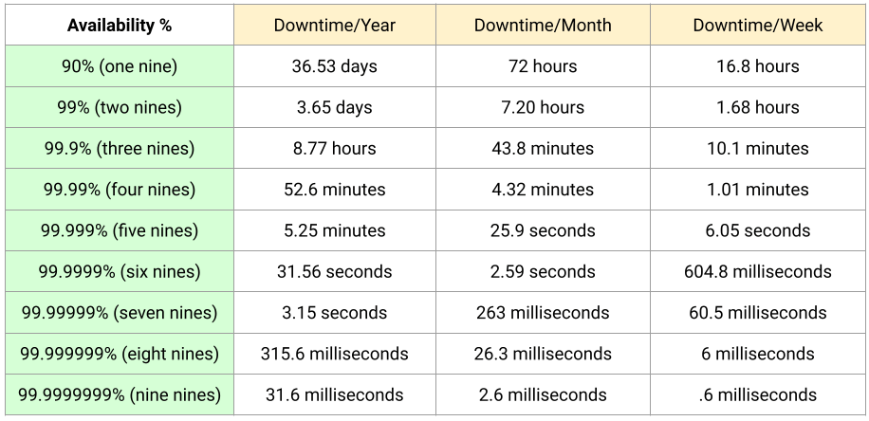
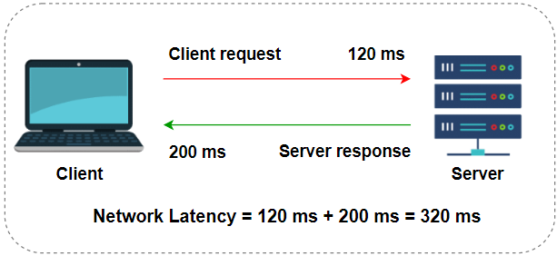
Network Latency and Availability

Slide 7
Composite SLA
Two virtual machines.
One instance of Azure SQL Database.
One instance of Azure Load Balancer.
Composite SLA
= 99.9% × 99.9% × 99.99% × 99.99%
= 0.999 × 0.999 × 0.9999 × 0.9999
= 0.9978
= 99.78%

Slide 8
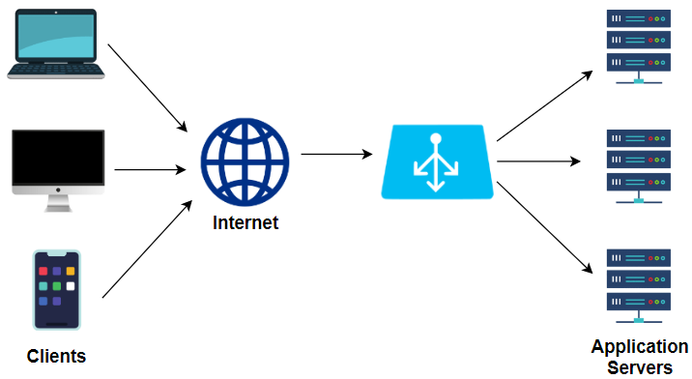
Load Balancing
A technique used to distribute workloads across multiple computing resources, such as computers, network links, or disks.
Load Balancing Algorithms
  Round Robin: Distributes requests sequentially among the servers in the pool.
  Least Connections: Sends requests to the server with the fewest active connections.
  Least Response Time: Directs traffic to the server with the fastest response time for new connections.
  Least Bandwidth: Chooses the server that is currently serving the least amount of traffic.
  Weighted: Assigns more requests to servers with higher capacities based on predetermined weights.

Slide 9
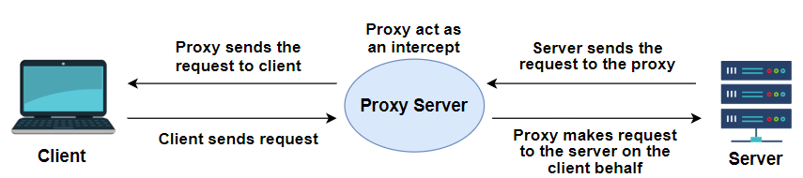
Proxies: Forward and reverse
Forward Proxy: Acts on behalf of clients or users. When a client makes a request, the forward proxy server evaluates the request, and if allowed, it then makes the request to the destination server and returns the response to the client.
For example, System used for internal networks and to control and monitor internet usage by users.
Reverse Proxy: Sits in front of web servers and forwards client (web browser) requests to those web servers.
Reverse proxies are typically used for load balancing, caching static content, SSL termination, and providing additional security for the web servers behind them.

Slide 10
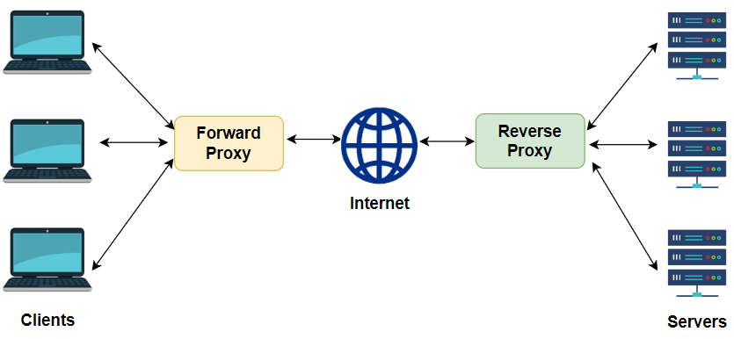
Forward and Reverse Proxy

Slide 11
Web Sockets and Long Pooling
Web Sockets: Provide a full-duplex communication channel, which means both the client and the server can send and receive data simultaneously over a single, persistent connection. This connection stays open, and data can flow in both directions in real-time, without needing to reconnect every time new data is sent.
Ideal for interactive applications where minimal latency is critical (like gaming, live chat, live updates).
Long Polling: Long polling is a workaround for situations where you need real-time communication but can’t use WebSockets. Here, the client makes a request to the server and waits for new data. The server keeps the connection open until it has new data to send, then responds with that data. Once the client receives the data, it immediately makes another request to the server.
Used as a fallback when WebSockets are not supported and it’s less efficient and more resource-heavy.

Slide 12
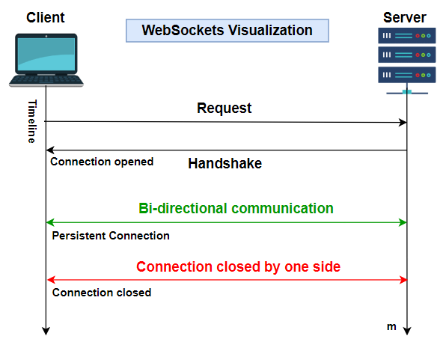
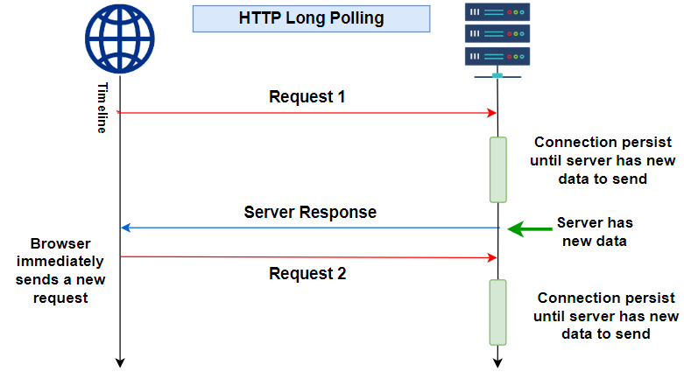
WebSockets vs Long Pooling

Slide 13
Throughput
Refers to the rate at which a system can process a certain amount of work.
Throughput is typically measured in:
  Operations per second
  Bits or bytes second per transfer
  Transactions per second
How to Optimizing Throughput in System Design
  Horizontal scaling
  Caching
  Load balancing
  Efficient algorithms

Slide 14
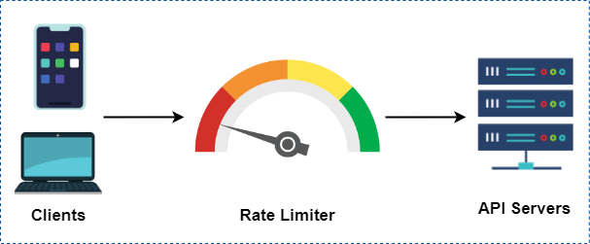
Rate Limiting
Restricts the number of requests a user can make to a system within a specific time.
Rate Limiting Methods
Request Queues: Limits number of requests per second and queues additional ones.
Throttling: Dynamically adjusts API use, possibly restricting or temporarily blocking high-frequency users. It operates at various levels like application, API, user.

Slide 15
Redundancy
Redundancy is a concept that applies to both databases and applications.
  Passive Redundancy: A setup where backup components are kept in a standby mode—they remain inactive and only "wake up" to take over when the primary component fails. There might be a slight delay in response after failover since the backup components needs to be activated or initialized before it start handling requests.
  Active Redundancy: Multiple components work in parallel, actively handling tasks and ensures high availability, minimal failover time. Useful for high-traffic situations demanding uninterrupted operation.
Database Redundancy ensures data persistence and recovery.
Application Redundancy ensures continuous functionality and service delivery
Notes:
Redundancy vs. Replication
Redundancy provides backup components for fault tolerance.
Replication creates consistent data copies across multiple components for data consistency and performance.

Slide 16
System Design Concepts For Databases

Slide 17
SQL Database and NoSQL Database
SQL Database: MySQL, PostgreSQL, Oracle, SQL Server
  Relational, structured schema
  Uses SQL for queries
  ACID-compliant for transactions
  Vertically scalable
  Best for complex relationships
NoSQL Database: MongoDB, Cassandra, Couchbase, DynamoDB
  Non-relational, flexible schema
  Custom query languages
  Horizontally scalable
  Optimized for unstructured data
  Prioritizes performance and scalability

Slide 18
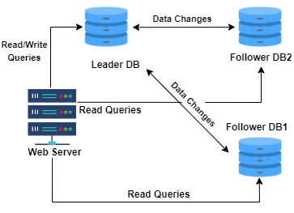
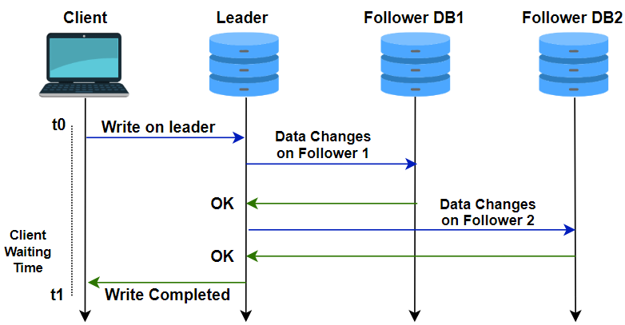
Master Slave Database
Master Node: All write operations (insert, update, delete) happen here. The master node then propagates these changes to the slave nodes.
Slave Nodes: These are read-only replicas of the master. They receive data from the master node and replicate the changes in near real-time. Slaves handle read operations for improving performance for read-heavy applications.
Notes:
It can be implemented for both SQL and NoSQL Databases.
Useful where read scalability is important, and the workload is read-heavy with relatively fewer writes.
Commonly used in scenarios like web applications, reporting systems, and multi-region deployments.
1. Active Geo-Replication (for Read-Only Replicas)
Azure SQL uses Active Geo-Replication to create readable secondary replicas in different regions. These replicas can be used for read operations (like a slave in a master-slave setup), but they are not slaves in the traditional sense. Instead, they are fully independent replicas that are kept in sync with the primary database (master) asynchronously.
Primary Database: The primary database handles both read and write operations.
Secondary Replicas: The secondary replicas are read-only and can be used to distribute read-heavy workloads.
2. Auto-Failover Groups
In Azure SQL, Auto-Failover Groups enable automatic failover to a secondary replica in case of a failure. This works similarly to the concept of failover in a master-slave setup but without the need for manually configuring and managing failover.
If the primary database becomes unavailable (e.g., due to a network issue, hardware failure, or region failure), the system can automatically fail over to the secondary replica, which becomes the new primary database.
This is a fully managed feature, and no manual intervention is needed.

Slide 19
Database Replication
A process of creating and maintaining identical copies of a database across multiple systems, servers, or locations.
Improve data availability, enhance system performance (especially for read-heavy applications), and ensure fault tolerance.
Replication ensures that data is consistently available in different geographic locations, reducing the risk of data loss due to system failures or disasters.
Cloud-based database Services like Azure SQL, Amazon RDS support database replication natively.

Slide 20
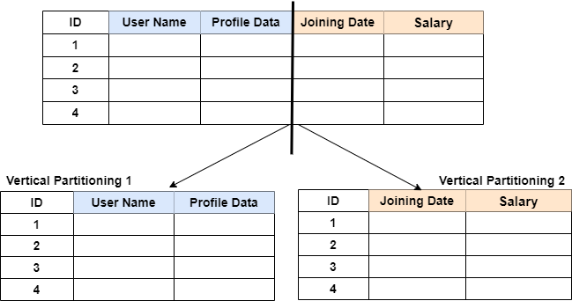
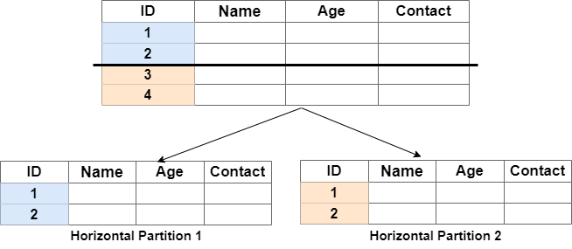
Database Partitioning
Dividing a database into smaller, more manageable pieces, where each partition can store data independently.
Enhance performance, maintainability, and scalability by allowing operations to be distributed across multiple hardware and storage systems.
Supported by SQL databases like MySQL, PostgreSQL etc.
Notes:
Partitioning Strategies
Horizontal Partitioning: Data is split into rows. For example, user data could be split by geographic region, with each region having its own partition
Vertical Partitioning: Data is split by columns. For instance, frequently accessed columns might be placed in one partition, and less frequently used ones in another.
Range, List, Hash Partitioning: These refer to how the data is divided within partitions—either based on a range of values, a specific list, or a hash function.
Goal: To improve query performance by reducing the size of each partition (i.e., each partition is smaller than the original dataset).
How to Query Data In Partition
1. Query Analysis (Partition Pruning)
The DBMS will then analyze the query to determine if the partition key is used in the query's conditions (such as in the WHERE clause). If the partition key is included in the query (e.g., querying by a specific user ID or date), the DBMS can prune unnecessary partitions from the query, meaning it will only query the relevant partition(s).
2. Routing the Query
Once the relevant partitions are identified (through partition pruning or explicit criteria), the DBMS routes the query to the correct partition(s):
Single Partition Query: If the query is fully contained within one partition (e.g., querying by a specific user ID in a user-based partitioning scheme), the query is sent to that partition.
Multiple Partition Query: If the query needs data from multiple partitions (e.g., a range query or when the partitioning key is not used in the query), the DBMS may issue the query to multiple partitions and then combine the results. This is known as scatter-gather.
3. Data Retrieval
The query is then executed within the relevant partition(s), and the results are retrieved. If multiple partitions are involved, the results may need to be merged or aggregated after retrieval.
4. Result Compilation
Once the query completes in each partition, the database will compile and return the final result. If multiple partitions were involved, this might require additional processing (such as sorting, aggregating, or joining data from different partitions) before returning the result to the user.
Challenges in Partitioning
Query Complexity: Queries that span multiple partitions (especially across a large number of partitions) can become more complex and slower, as data must be retrieved from multiple locations and then merged.
Joins Across Partitions: Performing joins on partitioned tables can be complex and resource-intensive, especially when the data spans across partitions.
Maintaining Partitioning Strategy: Over time, as data grows or usage patterns change, maintaining the partitioning strategy may require repartitioning or redistributing the data, which can be a complex and costly operation.

Slide 21
Database Sharding
Sharding is a form of partitioning where the data is horizontally partitioned into multiple, smaller databases or servers (often called shards). Each shard is independent and can reside on a different physical or virtual server.
Supported by NoSQL Databases like MongoDB, Cassandra, Couchbase etc.
Partitioning vs. Sharding
Scope: Partitioning happens within a single database, while sharding often refers to distributing data across multiple servers or systems.
Complexity: Sharding involves more complexity, including the need for a method to determine how data is distributed and how to access different shards.
Scaling: Sharding is typically used when horizontal scaling is required (more servers), while partitioning is a simple approach to improve performance within a single server or database.
Notes:
Partitioning Strategies
Horizontal Partitioning: Data is split into rows. For example, user data could be split by geographic region, with each region having its own partition
Vertical Partitioning: Data is split by columns. For instance, frequently accessed columns might be placed in one partition, and less frequently used ones in another.
Range, List, Hash Partitioning: These refer to how the data is divided within partitions—either based on a range of values, a specific list, or a hash function.
Goal: To improve query performance by reducing the size of each partition (i.e., each partition is smaller than the original dataset).
How to Query Data In Partition
1. Query Analysis (Partition Pruning)
The DBMS will then analyze the query to determine if the partition key is used in the query's conditions (such as in the WHERE clause). If the partition key is included in the query (e.g., querying by a specific user ID or date), the DBMS can prune unnecessary partitions from the query, meaning it will only query the relevant partition(s).
2. Routing the Query
Once the relevant partitions are identified (through partition pruning or explicit criteria), the DBMS routes the query to the correct partition(s):
Single Partition Query: If the query is fully contained within one partition (e.g., querying by a specific user ID in a user-based partitioning scheme), the query is sent to that partition.
Multiple Partition Query: If the query needs data from multiple partitions (e.g., a range query or when the partitioning key is not used in the query), the DBMS may issue the query to multiple partitions and then combine the results. This is known as scatter-gather.
3. Data Retrieval
The query is then executed within the relevant partition(s), and the results are retrieved. If multiple partitions are involved, the results may need to be merged or aggregated after retrieval.
4. Result Compilation
Once the query completes in each partition, the database will compile and return the final result. If multiple partitions were involved, this might require additional processing (such as sorting, aggregating, or joining data from different partitions) before returning the result to the user.
Challenges in Partitioning
Query Complexity: Queries that span multiple partitions (especially across a large number of partitions) can become more complex and slower, as data must be retrieved from multiple locations and then merged.
Joins Across Partitions: Performing joins on partitioned tables can be complex and resource-intensive, especially when the data spans across partitions.
Maintaining Partitioning Strategy: Over time, as data grows or usage patterns change, maintaining the partitioning strategy may require repartitioning or redistributing the data, which can be a complex and costly operation.

Slide 22
CAP Theorem (ConsistencyAvailabilityPartition Theorem)
A distributed system can only simultaneously guarantee two out of the three :
Consistency: Every read gets the most recent write or an error.
Availability: Every request gets a response, without guaranteeing it's the most recent write.
Partition Tolerance: The system continues to work despite network failures.
Relational DBs (MySQL, SQL Server) | Consistency + Availability | Traditional databases prioritize consistency and availability but aren't partition-tolerant.
NoSQL DBs (Cassandra) | Availability + Partition Tolerance | Ensures the system remains responsive but might return outdated or inconsistent data.
Distributed DBs (HBase) | Consistency + Partition Tolerance | Ensures data consistency but sacrifices availability during network partitions
Notes:
Consistency (C):
In a consistent system, every read operation will return the most recent write or an error. This means that all nodes in the system will always have the same data at any given time. If one node writes data, every other node in the system will immediately see the updated value after the write.
The trade-off is that in order to maintain consistency, a system may need to wait for all nodes to acknowledge a write operation, which can slow things down or make the system unavailable for short periods.
Availability (A):
Availability ensures that every request (read or write) receives a response, even if it's not the most up-to-date or correct response. The system is designed to be operational at all times, and it will always answer queries, even if some nodes are not up-to-date with the latest data.
The trade-off here is that, if the system guarantees availability, it may sometimes return outdated or inconsistent data because it doesn't wait for all nodes to confirm the latest write.
Partition Tolerance (P):
Partition tolerance means the system will continue to function even if there's a network failure or partition (when some nodes can't communicate with others). This is especially critical in distributed systems because network failures and delays can happen at any time, and the system needs to be able to tolerate these partitions.
The trade-off is that during network partitions, the system might not be able to guarantee either consistency or availability because some nodes might not be able to communicate with each other to synchronize data.

Slide 23
Storage
Volatile Storage (Memory):
  A fast and temporary, ideal for real-time data processing, system operations, and running applications.
  However, it requires constant power to retain data and loses everything when power is lost.
  Examples include RAM, cache memory, and registers.
Non-Volatile Storage:
  Retains data even without power, making it ideal for long-term storage needs.
  Slower than volatile memory but offers much higher capacity.
  Examples include HDDs, SSDs, USB flash drives, optical media, and magnetic tape.

Slide 24
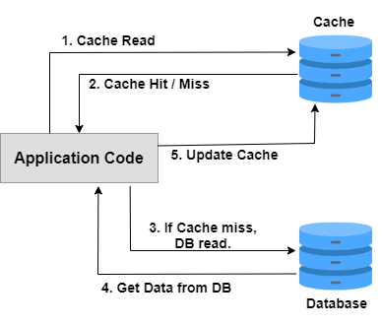
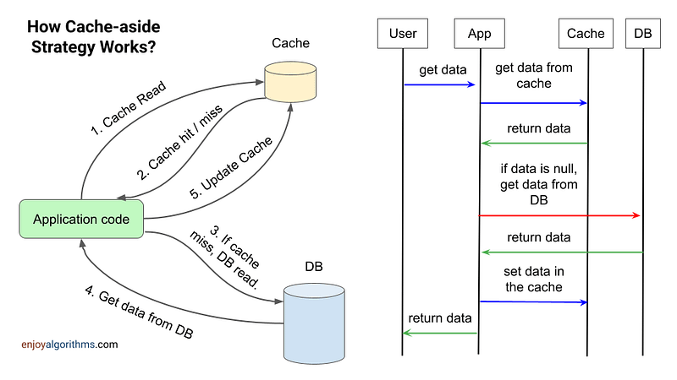
Caching
A technique used to temporarily store copies of data in a cache which is a high-speed data storage layer.
Used to server future requests for that data can be served faster.
Caching is a critical strategy for improving the efficiency and performance of a system.

Slide 25
Types of Cache
In-memory cache - Store data in RAM for low-latency access.
Distributed cache - Span multiple servers to provide a large pool of memory.
Database cache - Involve keeping frequently accessed query results.
Web caching - Web pages are stored temporarily to reduce server load, bandwidth usage, and perceived lag.

Slide 26
Key Value vs Cache
Key-value Database - A persistent storage system used for managing data sets where each item is stored as a key-value pair. Designed for durability and often supports complex data types.
Cache - A temporary storage layer that keeps a subset of data in memory for high-speed access, improving performance by reducing data retrieval times. A volatile storage where data can be lost on restarts or stop.

